Slide 1

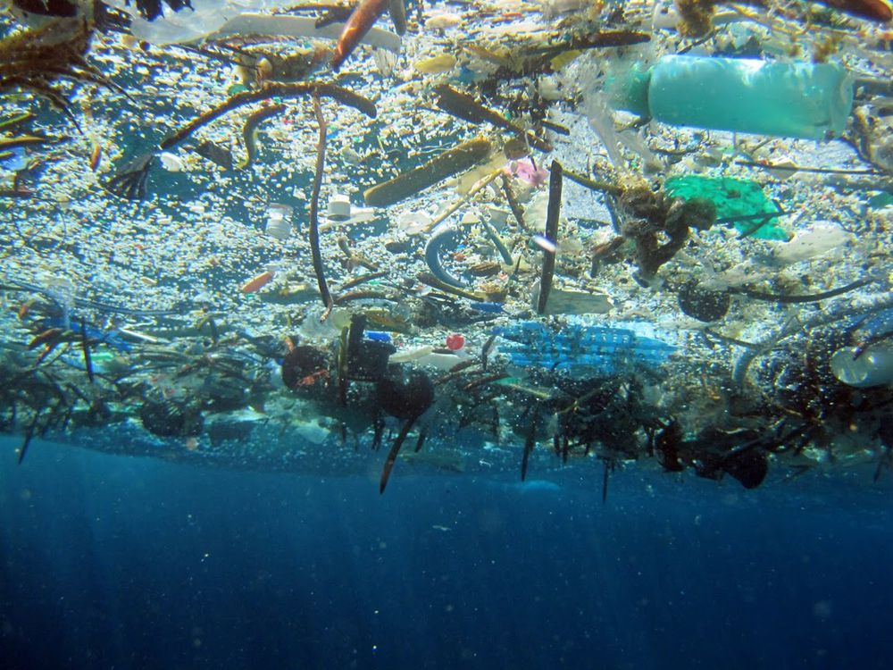
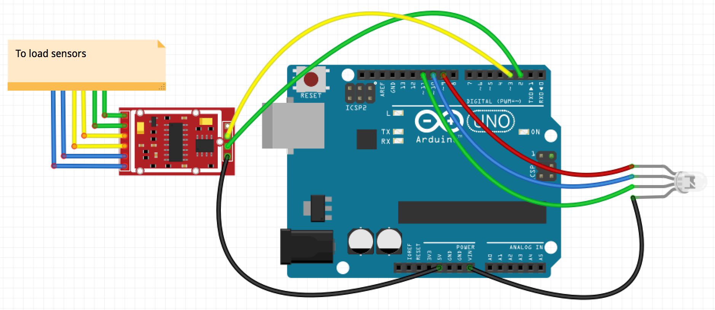
Rebound and Recycle
Incentivizing recycling to reduce waste
Problem
Without a direct incentive, some people may be unwilling to put forth the effort to recycle
Recyclable materials are often wasted and can lead to widespread waste accumulation as seen in the Great Pacific Garbage Patch
Solution
Encourage recycling by making it into a game
Participants will increase a displayed score by adding more recyclables to the bin
Offices and classrooms could award prizes when certain recycling goals are met
Provide educational information to give users a greater understanding of how to get involved in their community
Credit: National Geographic
Final Product
A 100% recyclable, recycling game
Score is displayed by RGB LEDs gradually shifting from red to green as weight approaches final value
Load Sensors Measure Weight
Weight below 0 lbs
Weight between 0-20 lbs
Weight above 20 lbs
Set color to red
As weight increases: ↑green intensity ↓red intensity
Set color to green
Beta Testing
The amount of recycling in a normal recycling bin after two days was compared to the amount in the Rebound and Recycle after two days
Participants in the Forest dormitory were entered into a raffle for a Starbucks gift card once the goal weight was reached
Recycling changed by X amount
To load sensors
Future Directions
Create a more diverse line-up of recycling games that could encourage recycling in specific environments

